Slide 1
UDEMY COURSES
An overview into Udemy’s market and Analysing the Udemy Organisation data

Slide 2
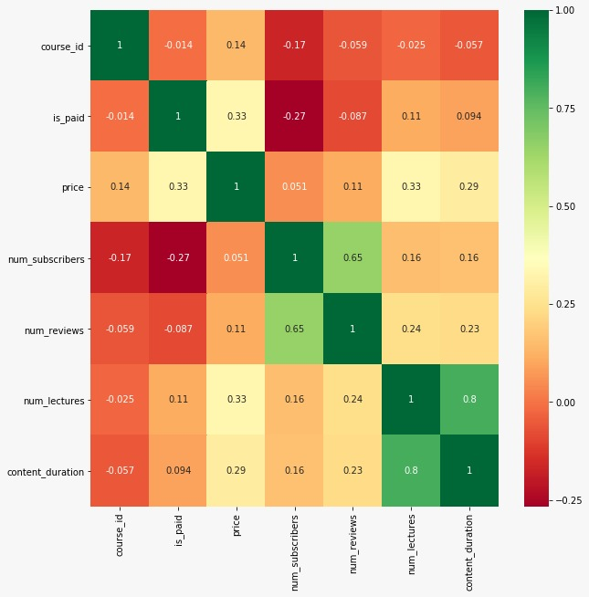
The heat map of correlation matrix.
It shows the relation between number of lectures and content duration.
It implies that when lectures keep increasing, content duration proportionately increases

Slide 3
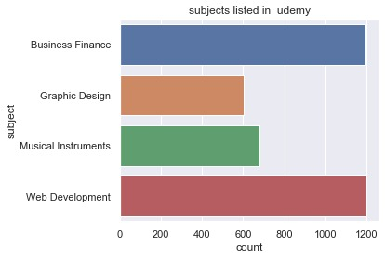
Web Development and business finance are on the highest of demands and subscriptions.

Slide 4
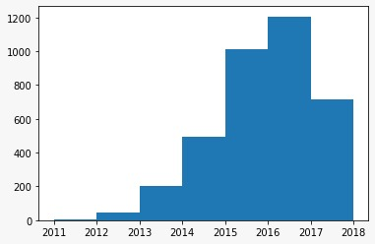
The number of distinct subscriptions in Udemy increased by over 80% in the period of 2014-2015. From 2015-2016, the subscriptions increased sparingly but decreased in 2017.

Slide 5
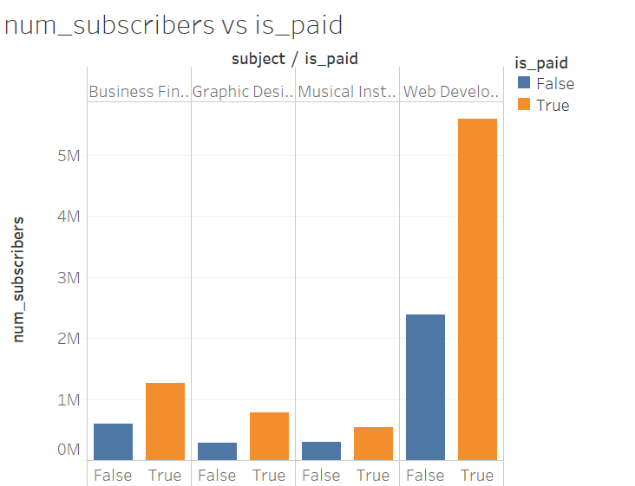
Web Development has most number of paid subscribers.

Slide 6
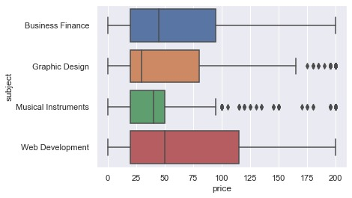
The average price of Web Development is 50$
That of musical instrument course is 40$(approx.)
Business Finance follows at 45$.
Graphic designing is at 30$.
A careful analysis shows that upper quartile for Web Development is larger. The reason for this implies that the outliers present in the prices of Web Development courses are as high as 120$.

Slide 7
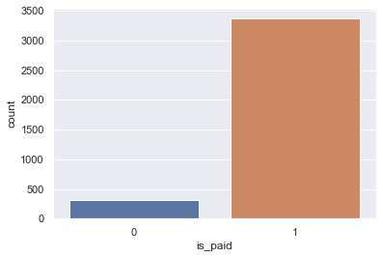
This bar graph implies that there are more paid courses in Udemy than free courses.

Slide 8
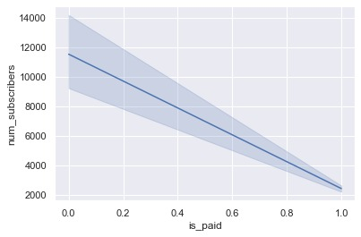
Greater number of subscribers are reluctant to paid courses. Thus the decrease in the number.
The darker line shows the mean of the number of subscribers.
The greater proportion of paid courses implies the decrease in the Confidence Interval around the mean.

Slide 9
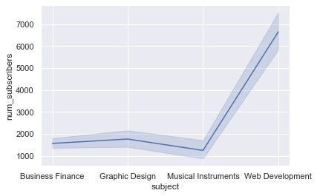
Users subscribed for Web Development ,almost 3 times than compared to remaining subjects.This shows the interest of users on Web Development

Slide 10
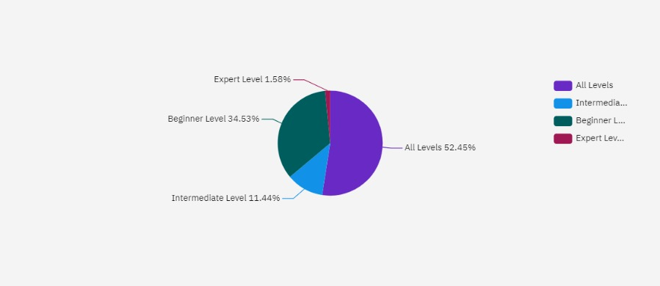
Amongst the different levels of courses present in Udemy, 87% of the courses belong to Beginner and All Levels.

Slide 11
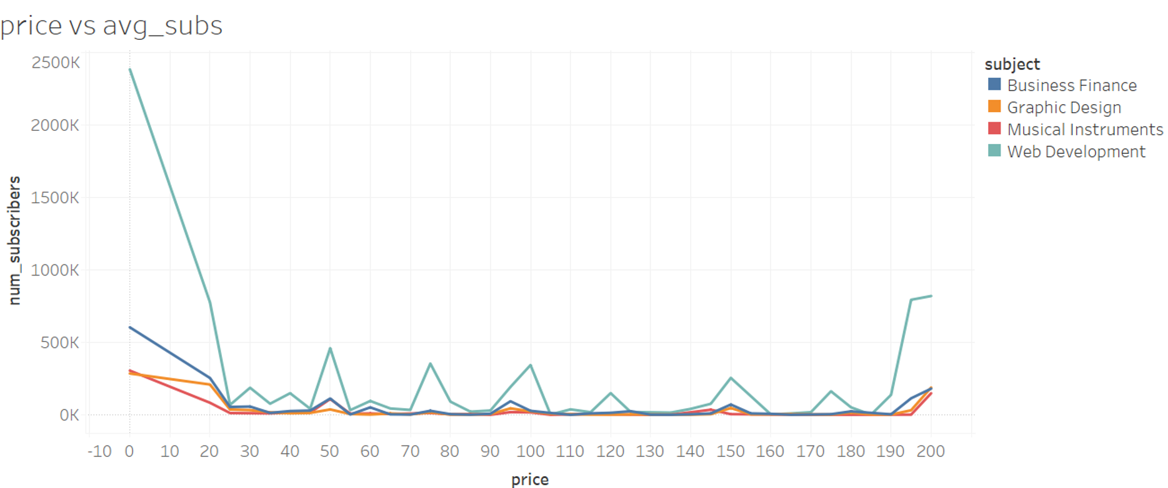
This predicts that maximum numbers of users opt not to pay nominal amounts. Analysing the full data in the prices range of 190 to 200.It shows that the users opt for courses which include all levels. In that classification also Web development shows the greatest number of both unpaid and paid subscription

Slide 12
Overview
Udemy has greater number of paid courses than unpaid ones. Paid users hold a significant portion of market for Web Development courses. But in general, there is a reluctance and decline in the number of subscribers as the proportion of is paid increases.
Analysing the data, paid users in Web Development in the period from 2014-2015 attribute to the growth of the organisation followed by Business Finance.
The greatest demand in the subject of Web Development and users opt to pay for courses including all levels.
The MOOC market underwent a growth in the number of users in 2014-2015 from a figure of 18 M to 35 M. Considering the rise in the global market by 94.4%, the rise in demand of Udemy Courses by 80% was evident but we attribute that demand to the global trend rather than individual development of Udemy.
Considering the period from after 2016, the dominators got a huge boost in the number of users, but Udemy underwent a decline.
The business perspective is that Udemy should increase courses of Web Development to multiply profits, also it should include courses on all levels.

Slide 13
THANK YOU

